Slide 1
Classification

Slide 2
Preprocessing for classification
Handling empty and NaN value.
Re-Indexing
Feature Selection

Slide 3
Classification Models
Logistic Regression:
Assumes there is linear relationship between features and target values.
Decision Tree:
Decision Tree captures both linear and non-linear relationship as they split the data hierarchically.
Random Forest:
Combine multiple decision trees to make better prediction.
XGBoost:
Unlike random forest, it creates one decision tree at a time and each tree tries to fix the mistake from the previous tree.

Slide 4
Evaluation metrics (Accuracy Score)
Accuracy: provide the overall correctness of predictions.
Precision: focus on producing false positive.
Recall: focus on producing false negative.
F1-Score: balance precision and recall.

Slide 5
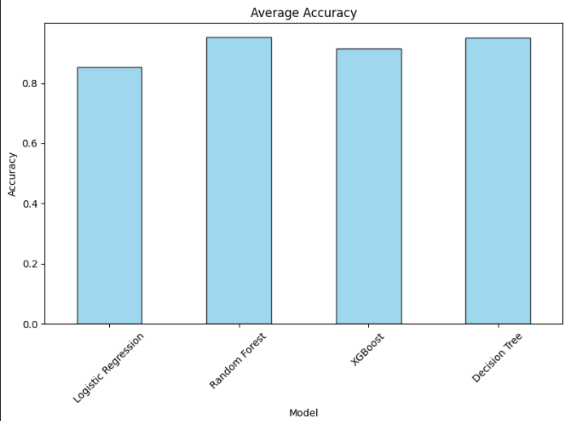
Average Accuracy

Slide 6
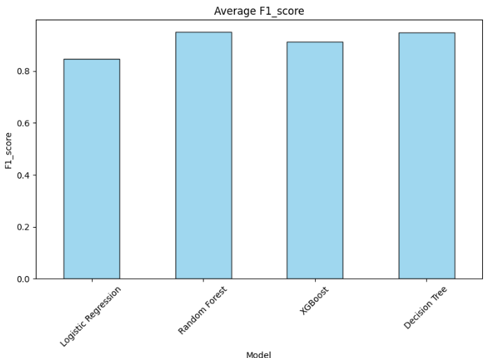
F1_Score

Slide 7
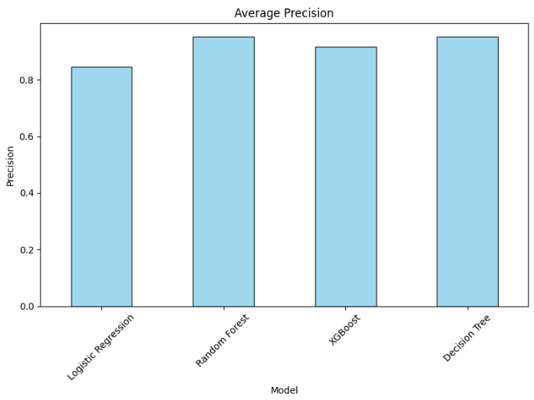
Precision

Slide 8
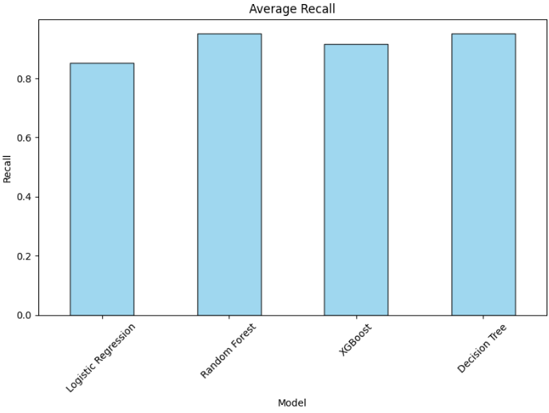
Recall

